Slide 1
ColorSense: A Study on Color Vision in Machine Visual Recognition
Ming-Chang Chiu, Yingfei Wang, Derrick Kim, Pin-Yu Chen, Xuezhe Ma
Ming-Chang Chiu
USC
mingchac@usc.edu

Slide 2
Visual Perception – a Color Vision Angle
DNN was inspired by human NN
No Color, No Fun/Modern Vision
Human is robust to Color
Q: What about Machines?

Slide 3
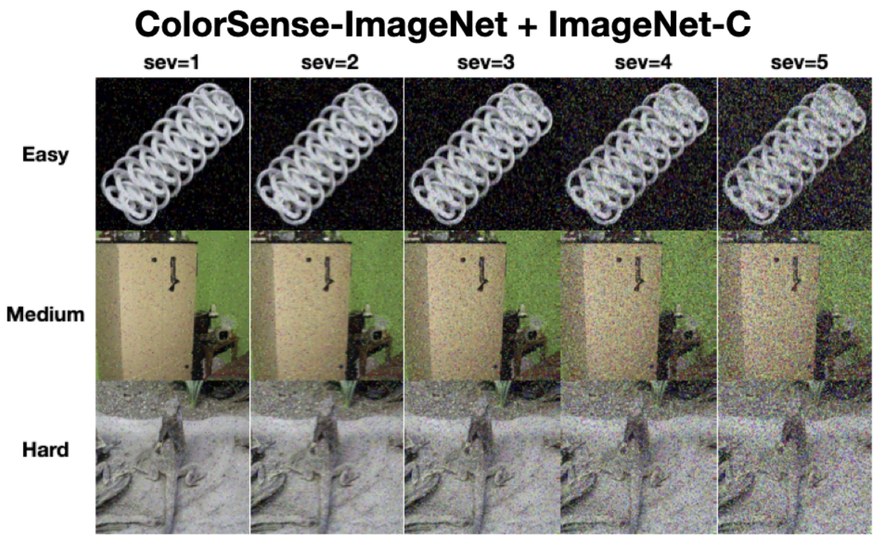
ColorSense Dataset – ImageNet & CIFAR
Notes:
In this work, we explored how color vision impacts machine perception by presenting COLORSENSE, a curated dataset with 110,000 human annotations of color labels derived from benchmarks like ImageNet and CIFAR10. We performed thorough evaluation on cutting-edge models with consideration of key factors such as model architecture, training objective, model size, training data and task complexity. We jointly analyzed the impact of color vision and image corruption. Our findings suggest that object recognition tasks are susceptible to color vision bias and environmental factors, and we highlight the need for new approaches toward the performance evaluation of machine perception models in real-world applications.

Slide 4
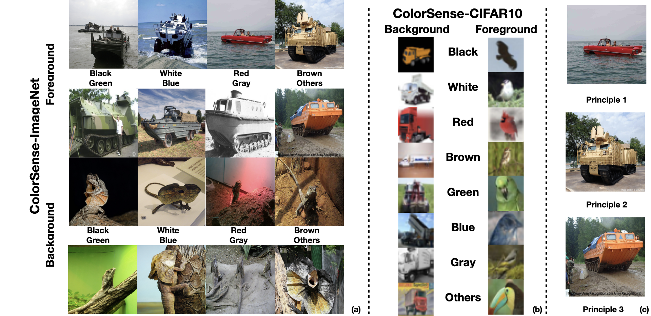
110,000 Human Anno., 8 Colors, 3 Difficulties

Slide 5
Major contribution
COLORSENSE Dataset for Color Vision
COLORSENSE-IMAGENET (50,000 human annotated images)
Images categorized based on dominant foreground/background color and their color discrimination levels
Comprehensive evaluation framework for Visual Robustness
Integrates COLORSENSE with ImageNet-C to study robustness under noisy conditions
Propose new metrics to quantify the impact of color vision on performance
Downstream Applications
Study spurious correlation in machine learning models
Study fairness and robustness in safety-crucial tasks

Slide 6
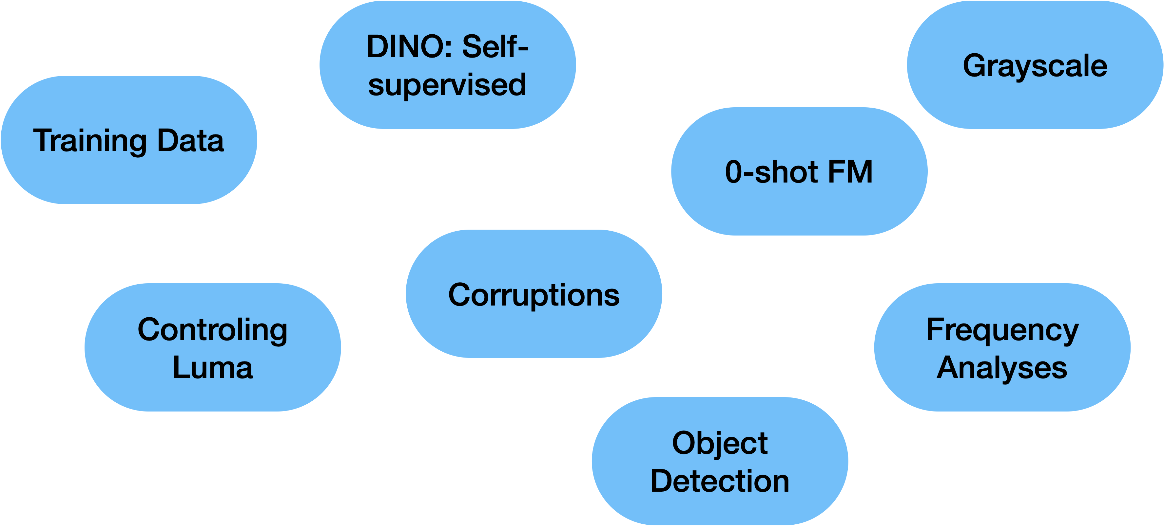
Primary Observations
Color Vision effect can’t be ignored!
Also Hard to mitigate!
Downstream Safety
DDI-CoCo (Med. Img.)
MegaCoin (VLM)

Slide 7
DNNs are affected by color vision bias
Model Size, Model Architecture, Training Methods
Trend: Consistent performance decrease from the Easy CD group to the Hard group for all models

Slide 8
Consistent pattern for self-supervised models and zero-shot learning foundation models

Slide 9
Advanced training setups marginally improve color vision bias

Slide 10
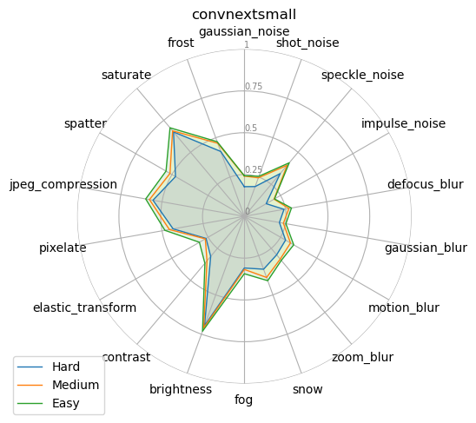
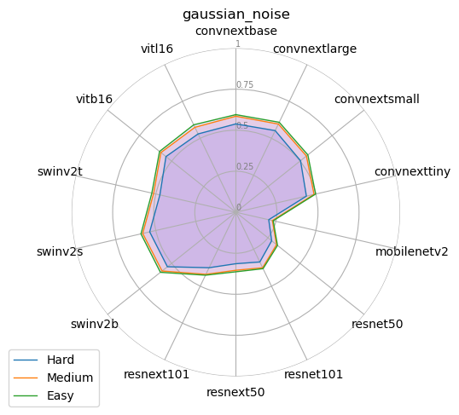
Color + Environment: Models can have different color vision behaviors in the presence of different environment factors
Notes:
Integrate COLORSENSE and imagenet-C

Slide 11
Metrics beyond overall model accuracy: Quantifying model robustness to color vision effect
Scaled color vision robustness
$$sCVR\left(↑\right)=\frac{acc_{tot}}{σ_{w}}$$
$$acc_{tot}=overall model accuracy$$
$$σ_{w}=\sqrt{\frac{\sum_{i=Easy}^{Hard}{w_{i}(acc_{i}−\overline{acc})}}{\sum_{i=Easy}^{Hard}{w_{i}}}}$$

Slide 12
Metrics beyond overall model accuracy: Quantifying model robustness to color vision effect
Scaled color vision robustness
Scaled corruption robustness
$$sCVR\left(↑\right)=\frac{acc_{tot}}{σ_{w}}$$
$$sCR\left(↑\right)=\frac{acc_{tot}}{σ_{s}}$$
$$acc_{tot}=overall model accuracy$$
$$acc_{tot}=overall model accuracy$$
$$σ_{w}=\sqrt{\frac{\sum_{i=Easy}^{Hard}{w_{i}(acc_{i}−\overline{acc})}}{\sum_{i=Easy}^{Hard}{w_{i}}}}$$
$$σ_{s}=\sqrt{\frac{\sum_{s=1}^{5}{ (acc_{s}−\overline{acc})}}{\sum_{s=1}^{5}{w_{s}}}}$$

Slide 13
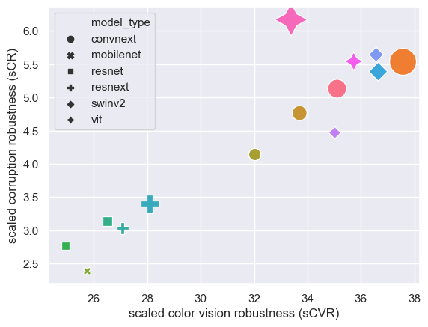
2 Metrics beyond overall model accuracy: Quantifying model robustness to color vision effect
Scaled color vision robustness
Scaled corruption robustness
$$sCVR\left(↑\right)=\frac{acc_{tot}}{σ_{w}}$$
$$sCR\left(↑\right)=\frac{acc_{tot}}{σ_{s}}$$
$$acc_{tot}=overall model accuracy$$
$$acc_{tot}=overall model accuracy$$
$$σ_{w}=\sqrt{\frac{\sum_{i=Easy}^{Hard}{w_{i}(acc_{i}−\overline{acc})}}{\sum_{i=Easy}^{Hard}{w_{i}}}}$$
$$σ_{s}=\sqrt{\frac{\sum_{s=1}^{5}{ (acc_{s}−\overline{acc})}}{\sum_{s=1}^{5}{w_{s}}}}$$
sCVR and sCR can be generalized to measure any type of
variability of model performance between subgroups

Slide 14
Probing potential root causes of color vision bias
Chroma?
Luma?
Frequency components?
Low Frequency Components seems to be blame

Slide 15
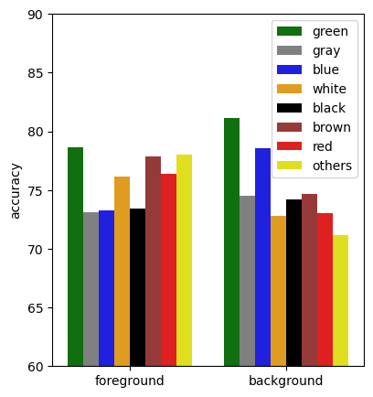
Additional Utilities of COLORSENSE
Study background and foreground colors as spurious correlations
Fairness/DG PPL!
Subgroups in training set as well!
MegaCoin (https://arxiv.org/abs/2412.03927)

Slide 16
Acknowledgements
Yingfei Wang, Derrick Kim, Pin-Yu Chen, Xuezhe Ma

Slide 17
Primary Observations
Color effect can’t be ignored!
Also Hard to mitigate!
Downstream Safety
DDI-CoCo (ICASSP)
MegaCoin (In Review)
Fairness/DG PPL!
Subgroups in training set as well!
MegaCoin (https://arxiv.org/abs/2412.03927)

Slide 18
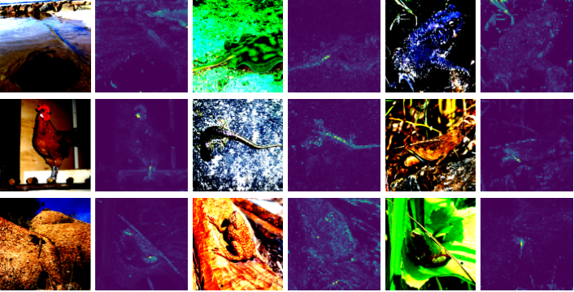
Thank you!
btw AI failed these test cases, can you tell what they are? 🧐

Slide 19
Backup slides

Slide 20
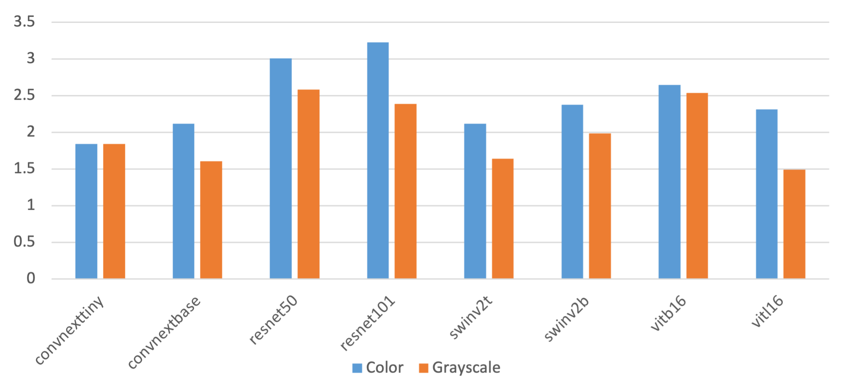
Probing potential root causes of color vision bias
Chroma? - Less color vision bias on greyscale images

Slide 21
Probing potential root causes of color vision bias
Chroma? - Less color vision bias on greyscale images
Luma? - Bias persists after controlling for luma
Notes:
Table 3: the color vision effect remains after controlling for luma.
Results reported in HARD/MEDIUM/EASY CD group format

Slide 22
Probing potential root causes of color vision bias
Chroma? - Less color vision bias on greyscale images
Luma? - Bias persists after controlling for luma
Frequency components? - bias driven by LFC in images
Notes:
Table IV: high and low frequency components accuracy (%)
Results reported in Resnet50 / ViT_L format

